Slide 1
Osmonov Meder
Football

Slide 2

Оценка знания о футболе
Untitled form
B I U T
Football
This form is automatically collecting emails from all respondents.Change settings

Slide 3
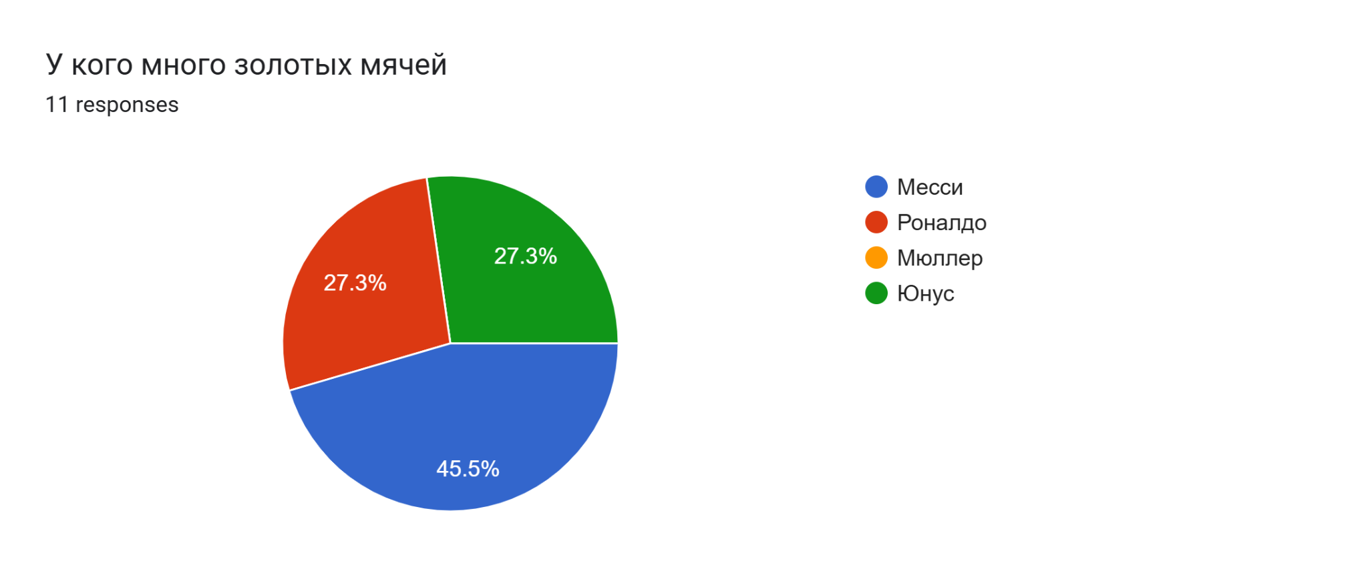

Slide 4
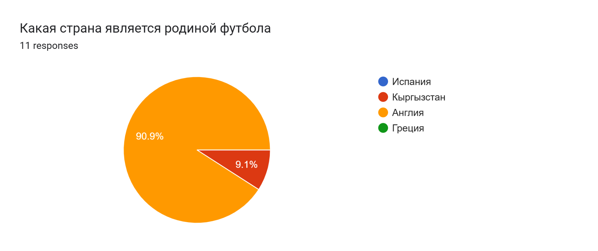

Slide 5
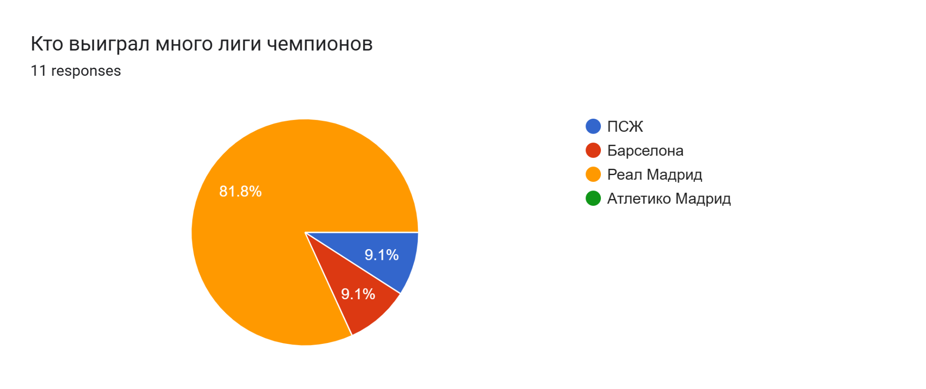

Slide 6
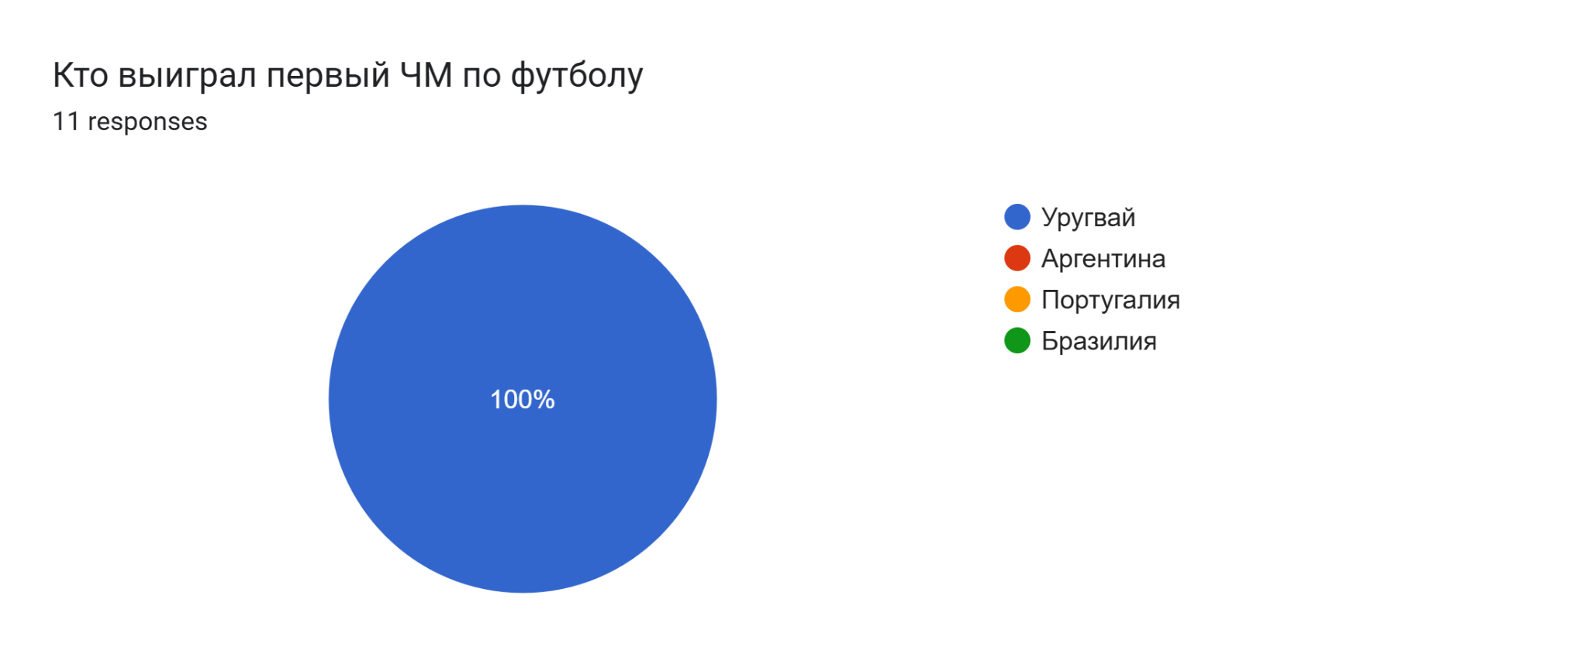

Slide 7
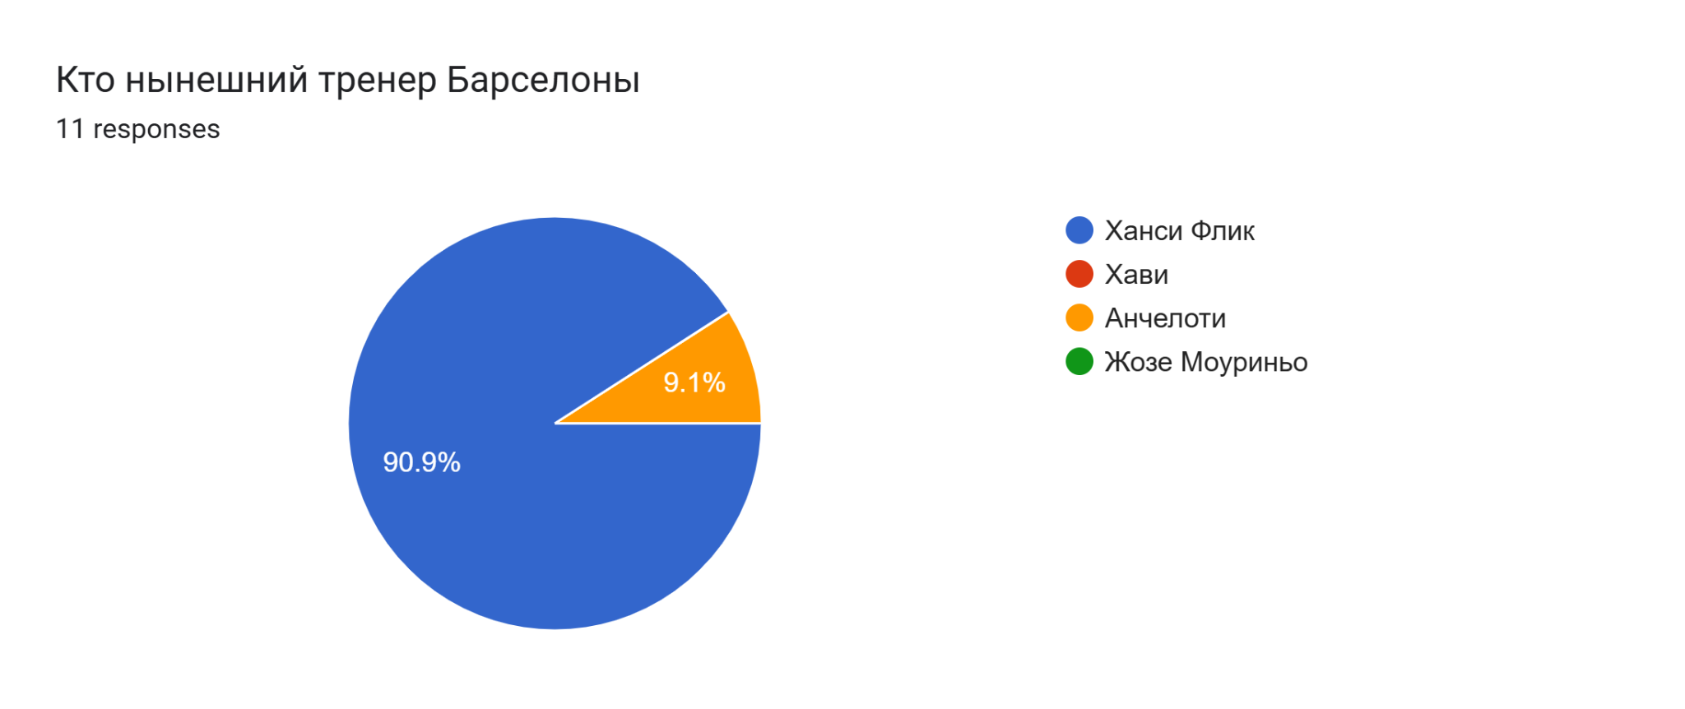

Slide 9
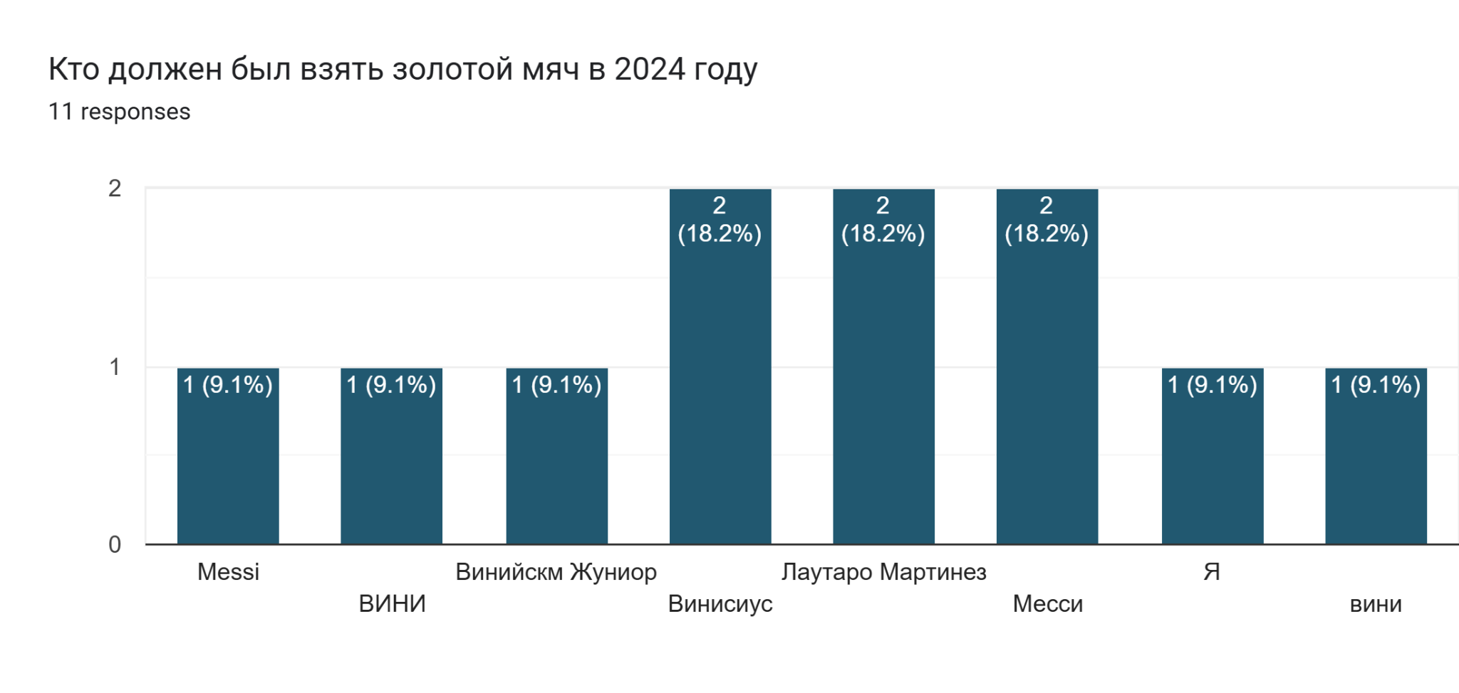

Slide 10
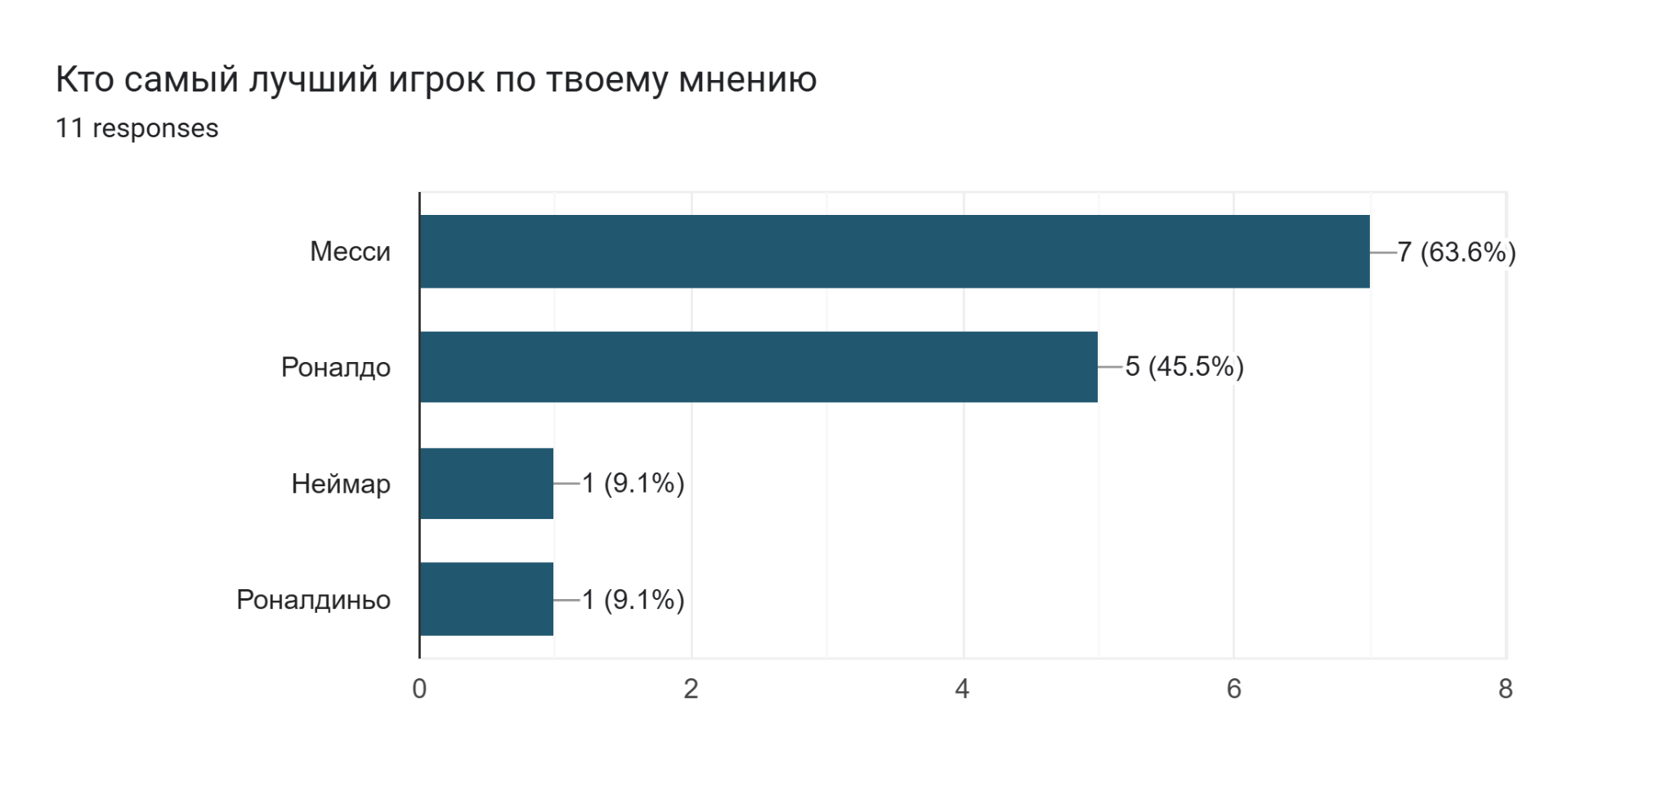

Slide 11
